Slide 1


Slide 2

Hardware
Arduino Uno

Slide 3
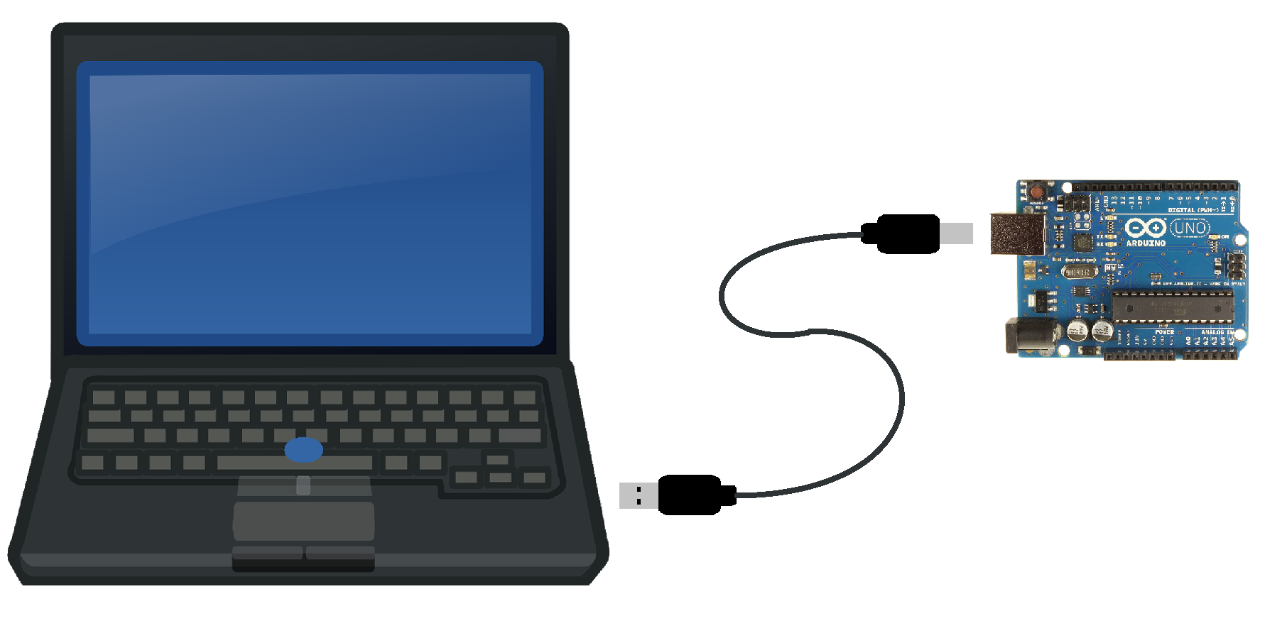
Powering & Programming the Arduino

Slide 4
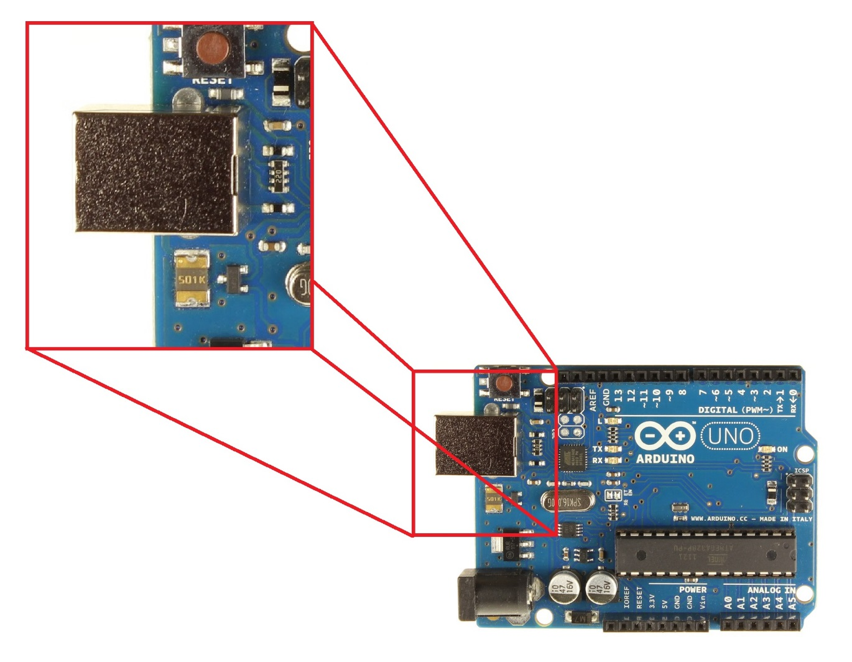
USB-Type B Port

Slide 5
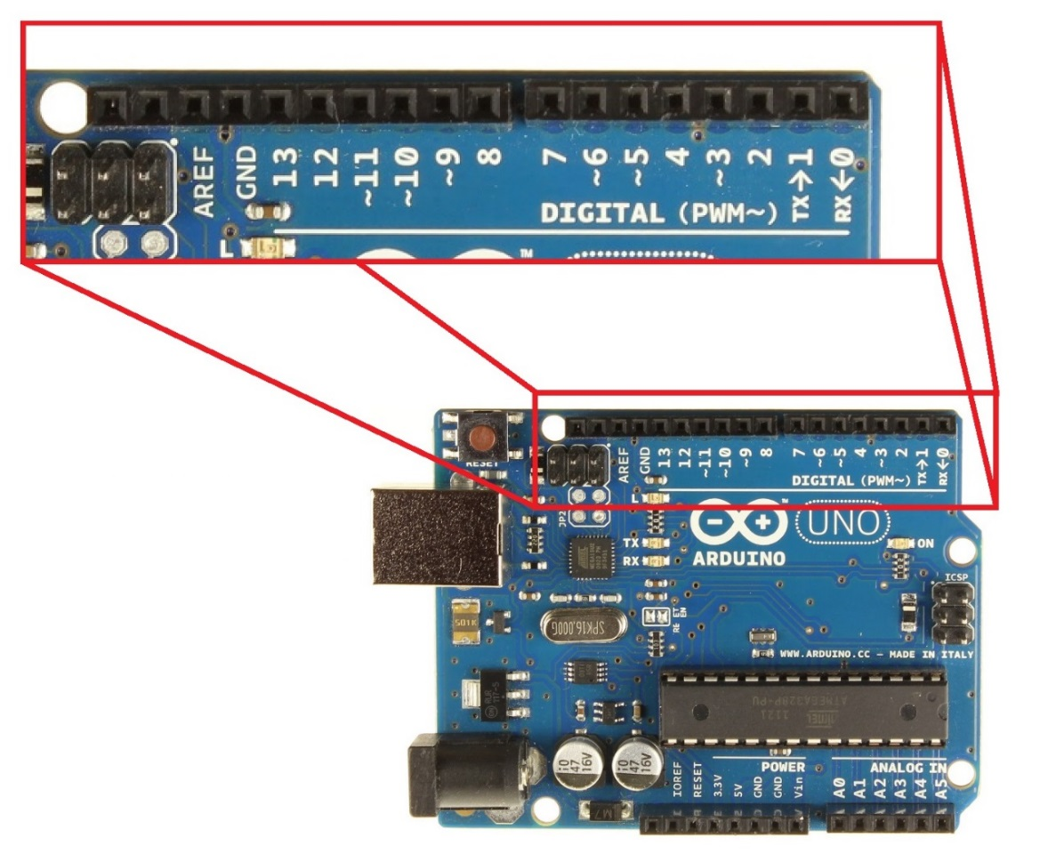

Digital Pins
Digital Signal
1 or 0
HIGH or LOW
5V or 0V
Example: A Light Switch

Slide 6
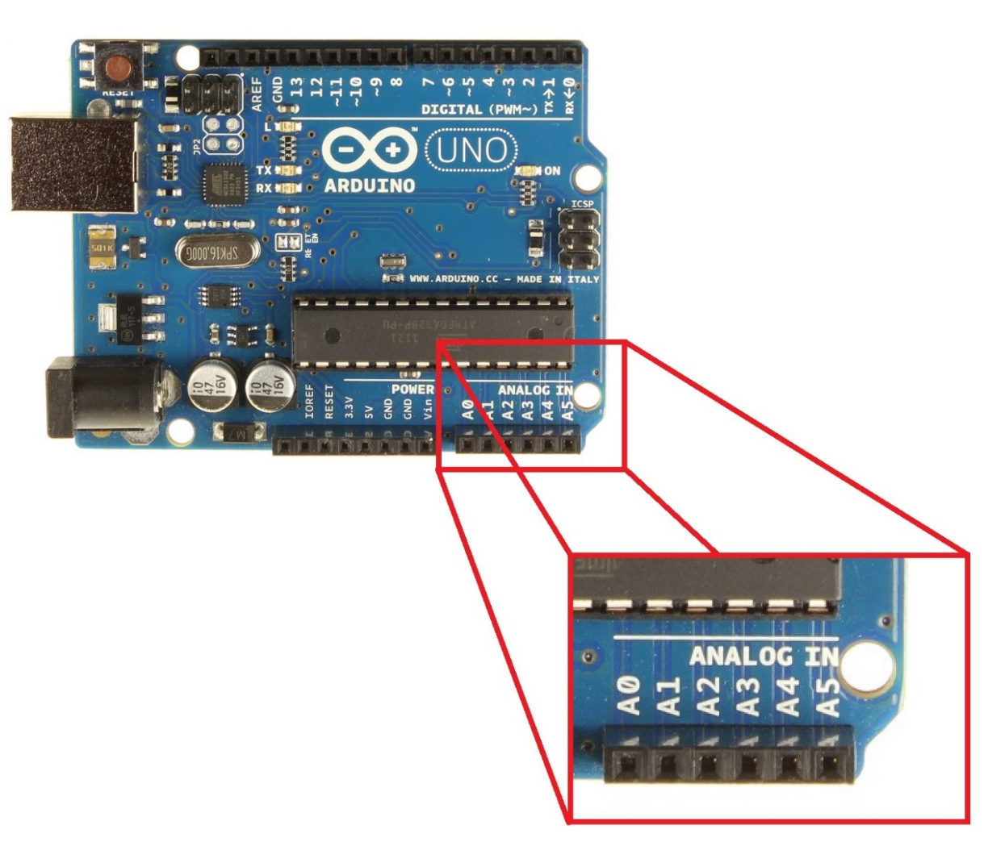

Analog Pins
Analog Signal
Varies
0V to 5V
Example: A Volume Knob

Slide 7
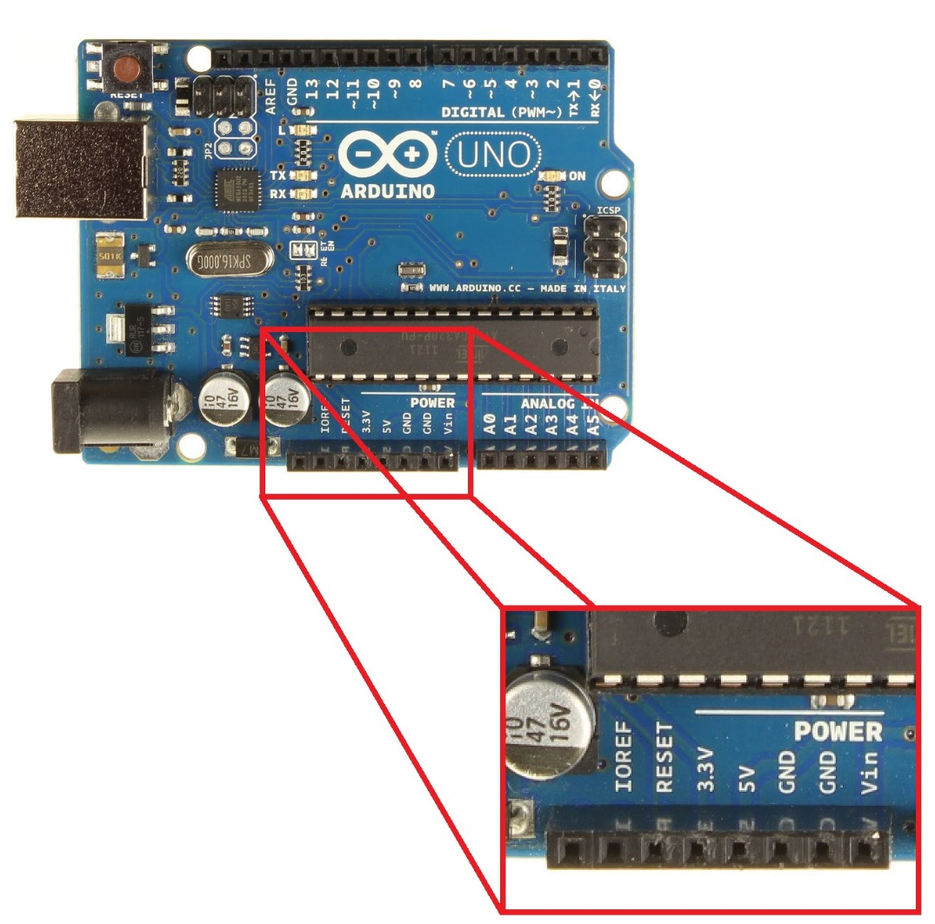
Power Pins
Provide and Receive
5V or 3.3V
Vin = Receive Power
GND = Ground
GND Rules!!
Arduino must always be grounded to any circuit that it is connected to

Slide 8
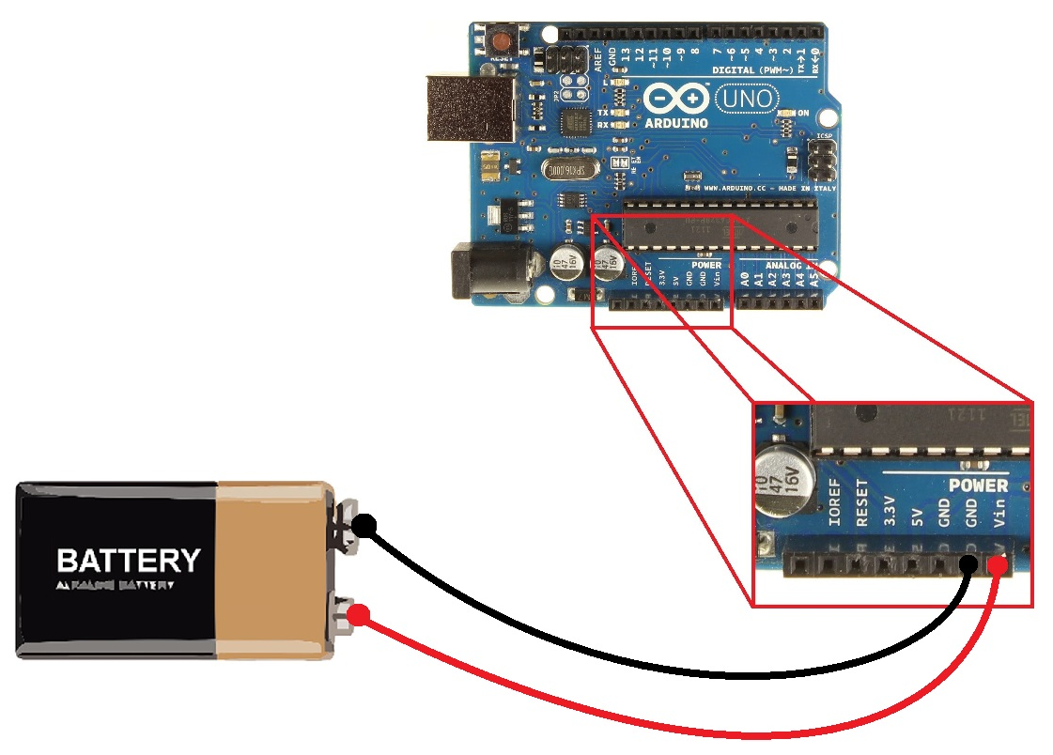
Powering the Arduino
Input Voltage
7-12 Volts Recommended
WARNING!!
Do not connect backwards

Slide 9
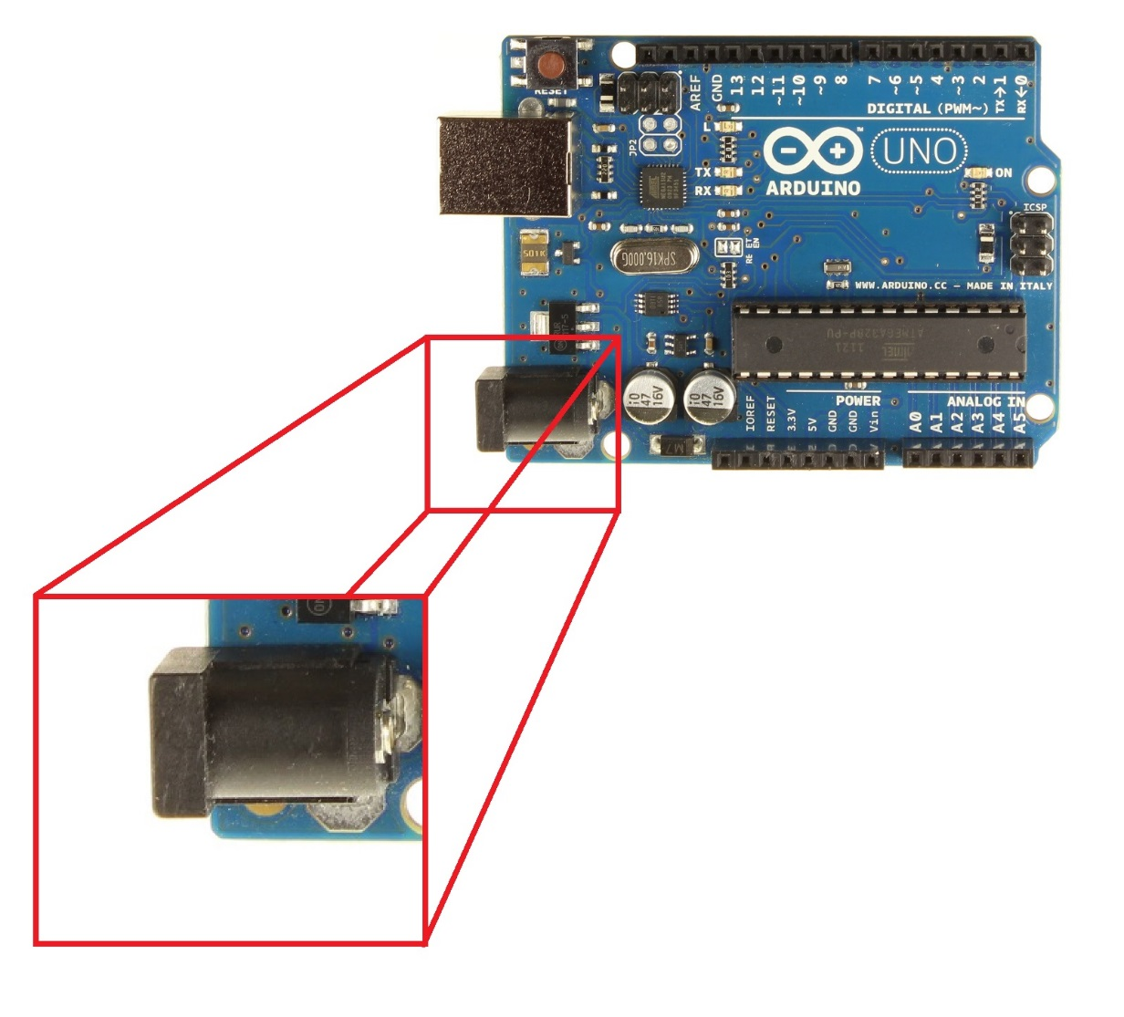
Powering the Arduino
Input Power
Barrel Jack

Slide 10
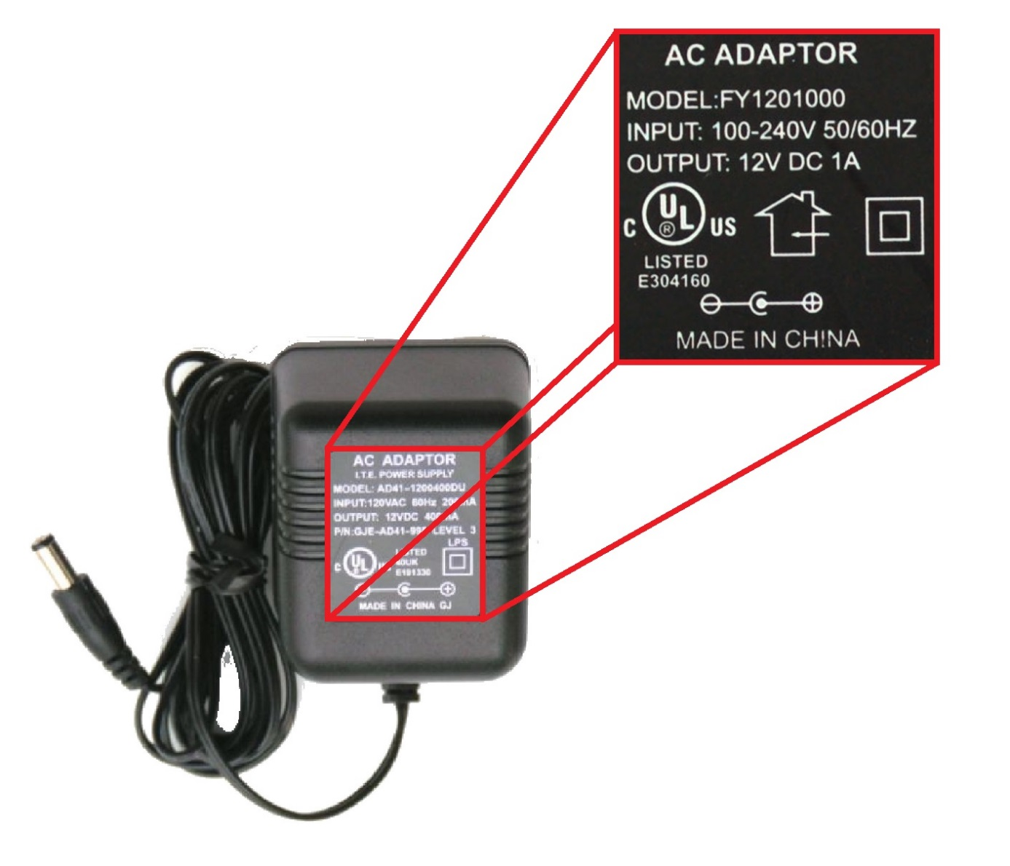
Power Supply
AC Adaptor
7-12 Volts Recommended
At least 250 milliAmps (mA)
WARNING!!
Plug must be center positive!!

Slide 11
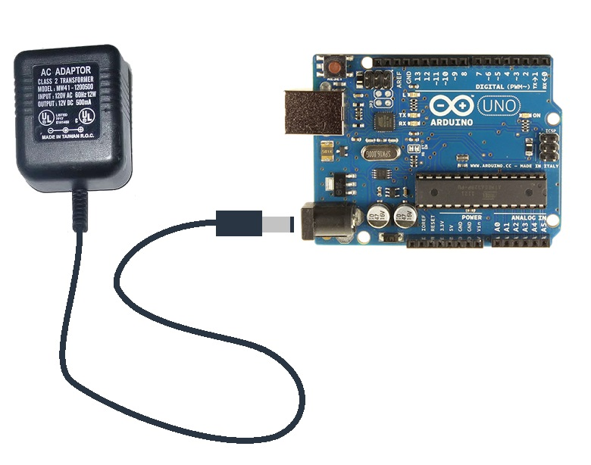
Powering the Arduino

Slide 12
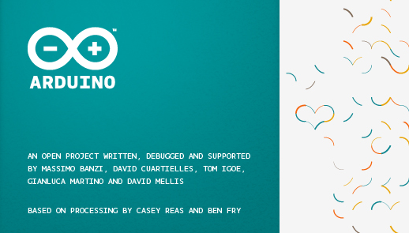
Software
Arduino IDE

Slide 13
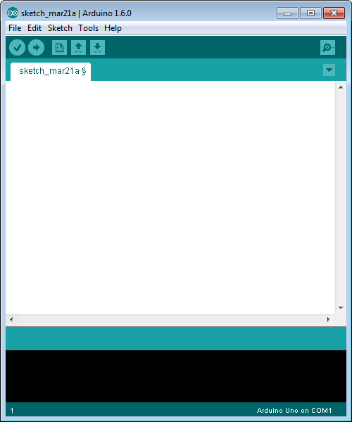
Blank Sketch

Slide 14
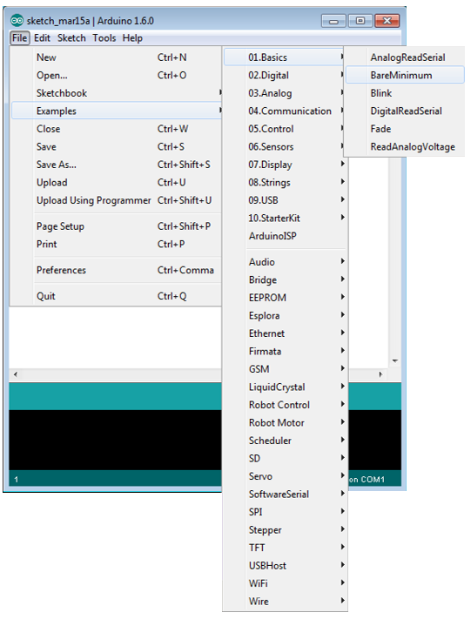
Find BareMinimum
File>Example>01.Basics>BareMinimum

Slide 15
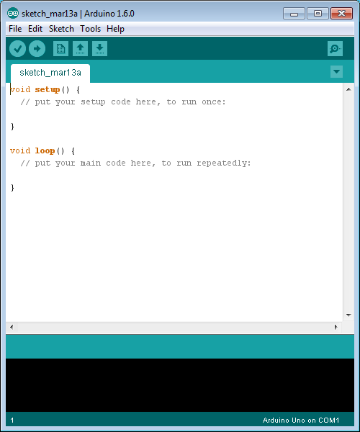
BareMinimum
void setup ()
Commands and variable declarations that need to be executed only once
Void loop ()
Commands and/or variable declarations that are constantly update

Slide 16
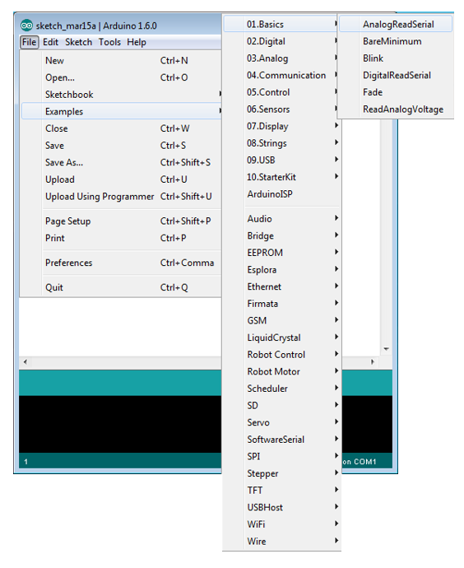
Find AnalogReadSerial
File>Examples>01.Basics>AnalogReadSerial

Slide 17
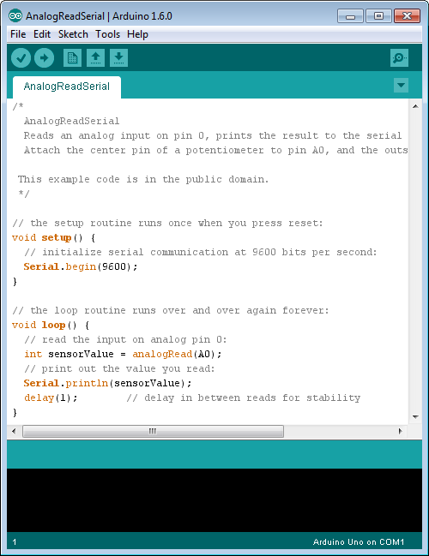
AnalogReadSerial
int x, y, josie
Serial.begin ()
analogRead ()
Serial.print ()
delay()

Slide 18

Resources

Slide 19
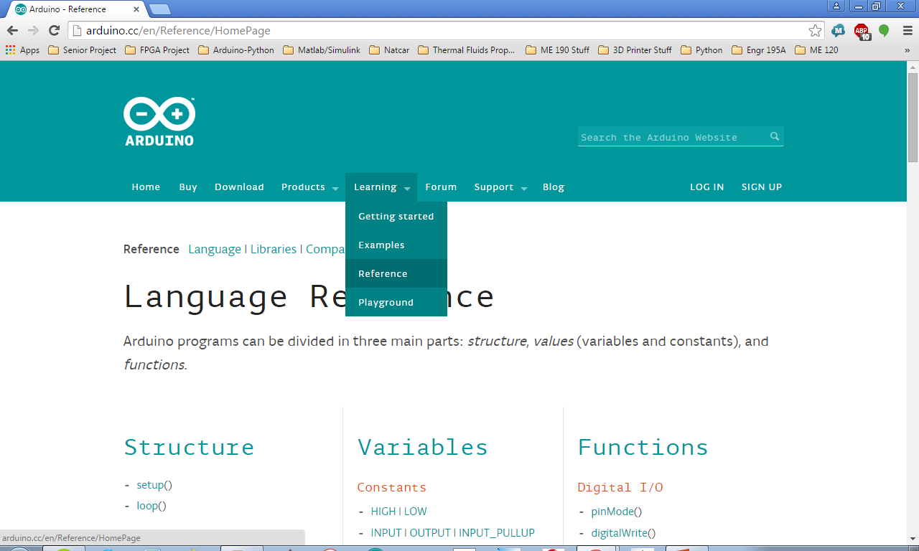
Learning>Reference

Slide 20
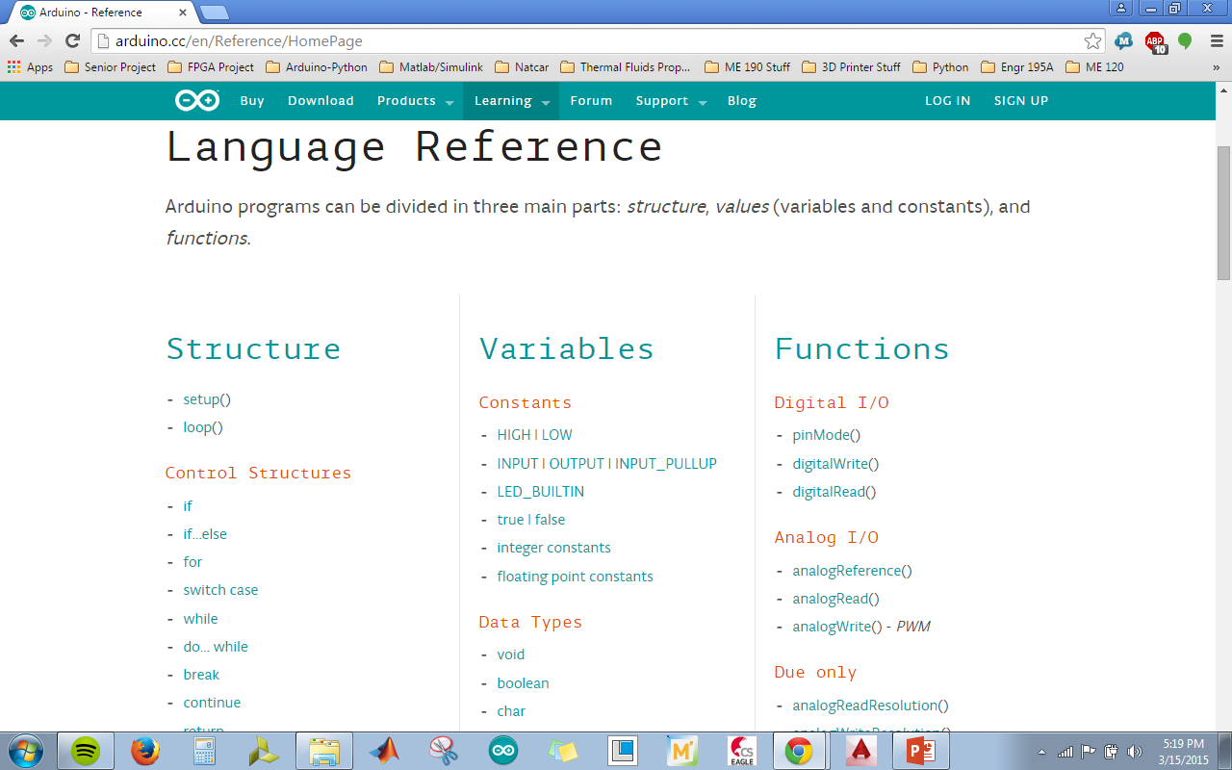
Commonly Used Commands

